Slide 1
Advanced Shell Finite Elements: Formulation, Implementation, Validation & Structural Modelling
Student: Peter Wilson
Supervisor: Andreas Winterstein

Slide 2
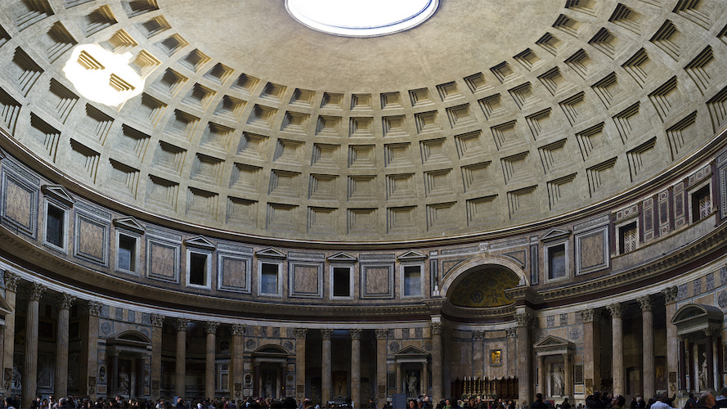
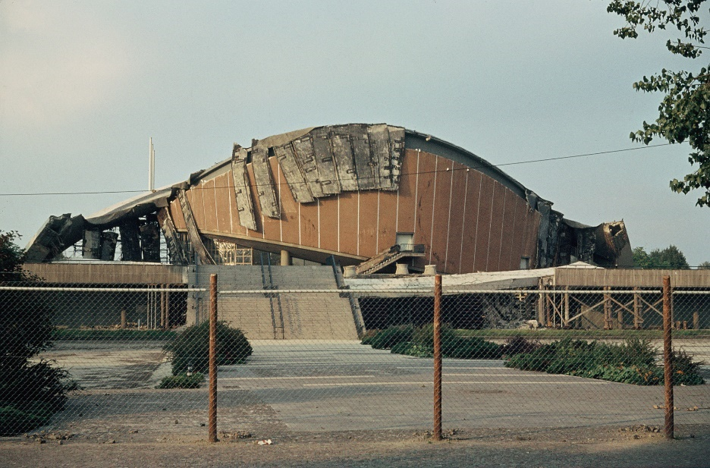
Shells: the Prima Donna of structures [1]
Shell structures:
Stellar performance vs. potential volatility
Scientific ethos:
Everything should be made as simple as possible, but no simpler
Roman Pantheon [2]
Berlin Congress Hall [3]
[1] E. Ramm and W. A. Wall. Shell structures - a sensitive interrelation between physics and numerics
[2] https://ka-perseus-images.s3.amazonaws.com/0415c3c2d2b70f98e9321c815e1b0fe1d6f8f570.jpg [3] https://www.hkw.de/media/bilder/2007_1/erinnernsiesich/lindemann/1980_05_lindemann_einsturz.jpg

Slide 3
Motivation and objectives
Motivation:
How can the risk of improper shell finite element analyses be managed?
Objectives:
Implement two advanced shell finite elements in the multi-physics code Kratos with the following functionality:
Geometrically linear/non-linear static/dynamic analysis
Linear elastic isotropic and orthotropic laminate materials
Recovery of stresses, strains and Tsai-Wu reserve factor
Investigate the structural modelling of advanced shell finite elements by examining the interaction between structural behaviour, base formulations, enhancing technologies and formulation-mesh-dependency.

Slide 4
Mechanical expression limitation: overview
Physical space
Mathematical shell model space (+ physics assumptions and limitations)
Low order shell finite element space (+ artificial locking effects)
Enhanced shell finite element space (+ enhancing technologies)

Slide 5
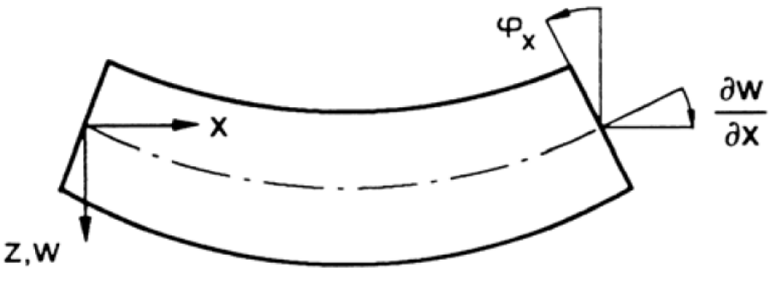
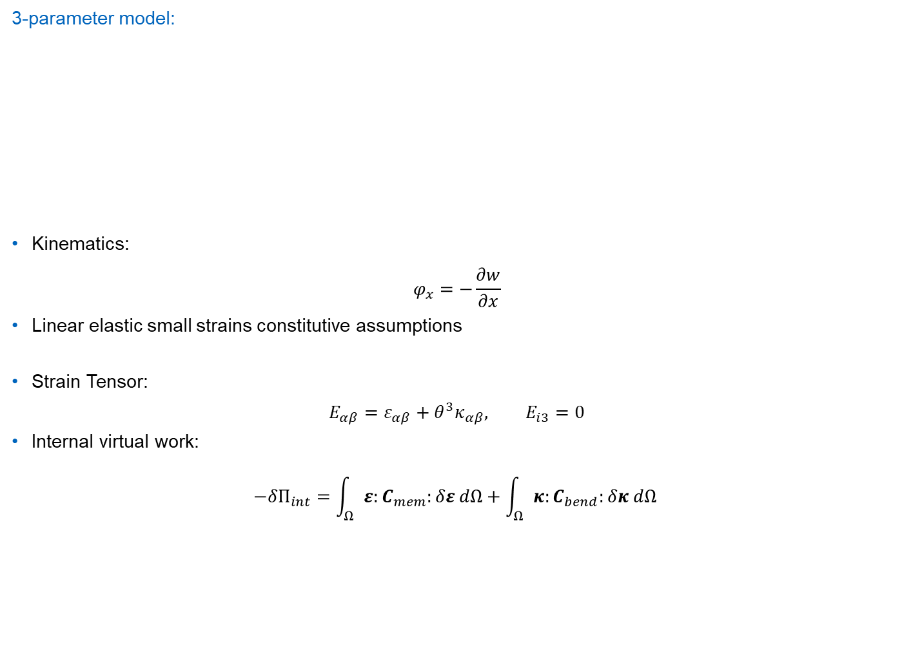
Mechanical expression limitation: mathematical shell models
3-parameter model:
Kinematics:
$$φ_{x}=−\frac{∂w}{∂x}$$
Linear elastic small strains constitutive assumptions
Strain Tensor:
$$E_{αβ}=ε_{αβ}+θ^{3}κ_{αβ}, E_{i3}=0$$
Internal virtual work:
$$−{δΠ}_{int}=\int_{Ω}{ε:C_{mem}:δε dΩ}+\int_{Ω}{κ:C_{bend}:δκ dΩ }$$

Slide 6
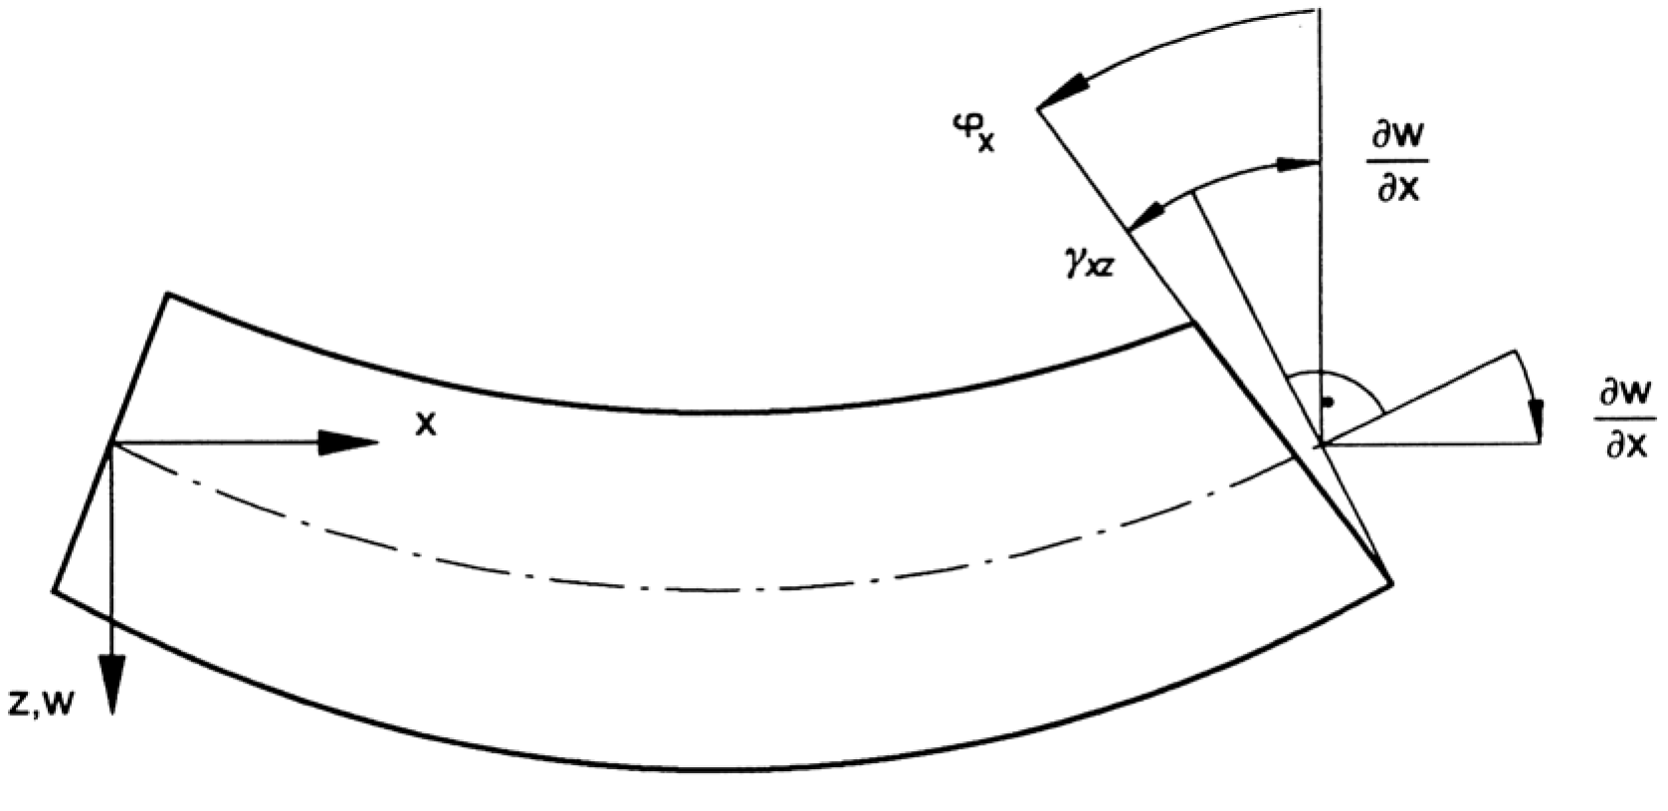
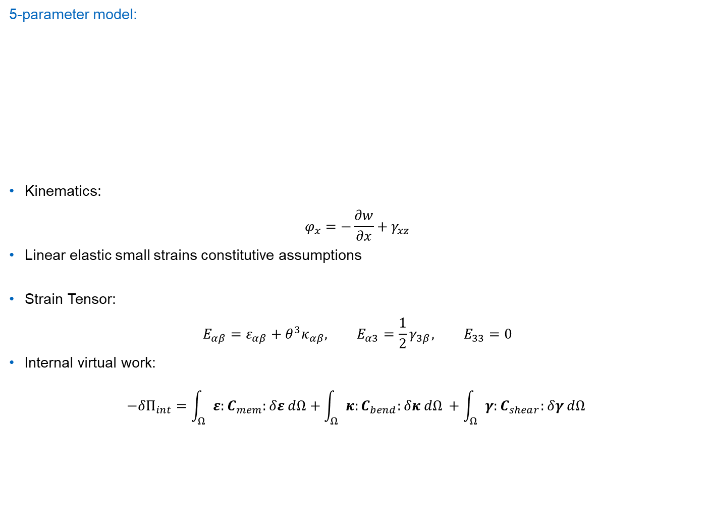
Mechanical expression limitation: mathematical shell models
5-parameter model:
Kinematics:
$$φ_{x}=−\frac{∂w}{∂x}+γ_{xz}$$
Linear elastic small strains constitutive assumptions
Strain Tensor:
$$E_{αβ}=ε_{αβ}+θ^{3}κ_{αβ}, E_{α3}={\frac{1}{2}γ}_{3β}, E_{33}=0$$
Internal virtual work:
$$−{δΠ}_{int}=\int_{Ω}{ε:C_{mem}:δε dΩ}+\int_{Ω}{κ:C_{bend}:δκ dΩ }+\int_{Ω}{γ:C_{shear}:δγ dΩ }$$
Additional rotation parameters necessary

Slide 7
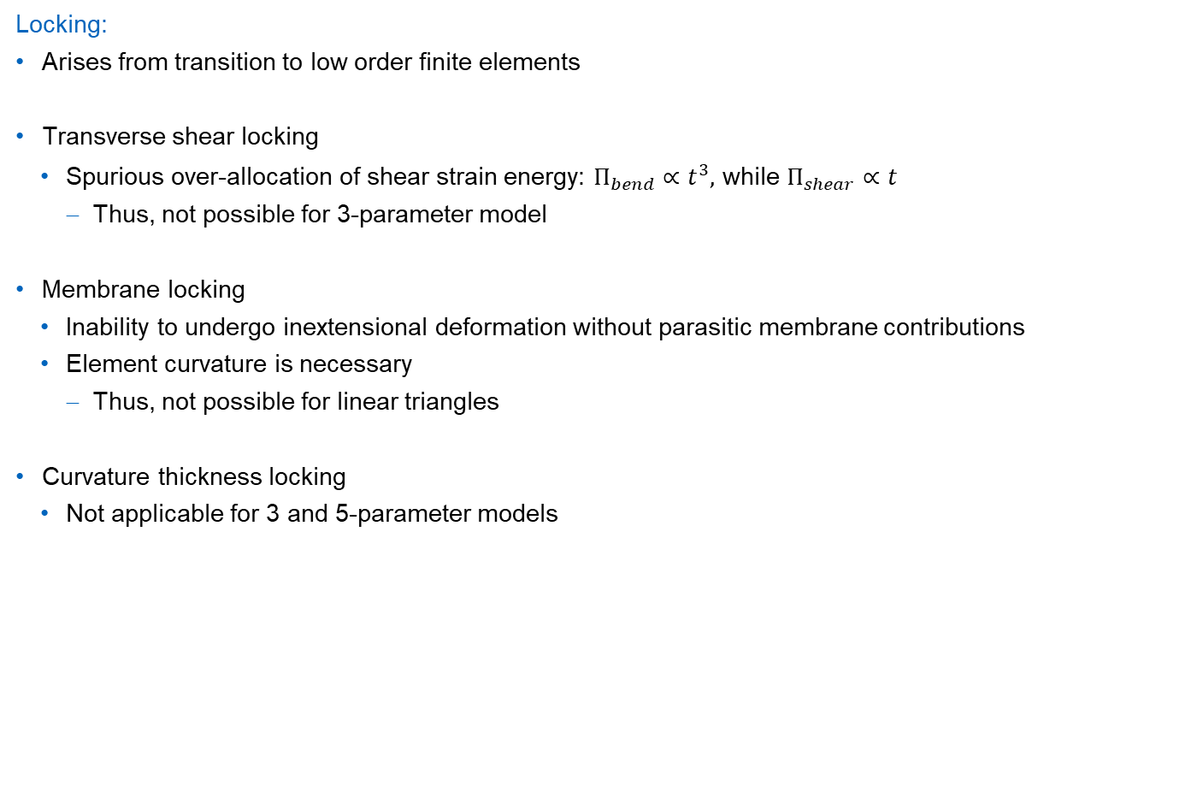
Mechanical expression limitation: artificial locking effects
Locking:
Arises from transition to low order finite elements
Transverse shear locking
Spurious over-allocation of shear strain energy: $Π_{bend}∝t^{3},$ while $Π_{shear}∝t^{}$
Thus, not possible for 3-parameter model
Membrane locking
Inability to undergo inextensional deformation without parasitic membrane contributions
Element curvature is necessary
Thus, not possible for linear triangles
Curvature thickness locking
Not applicable for 3 and 5-parameter models

Slide 8
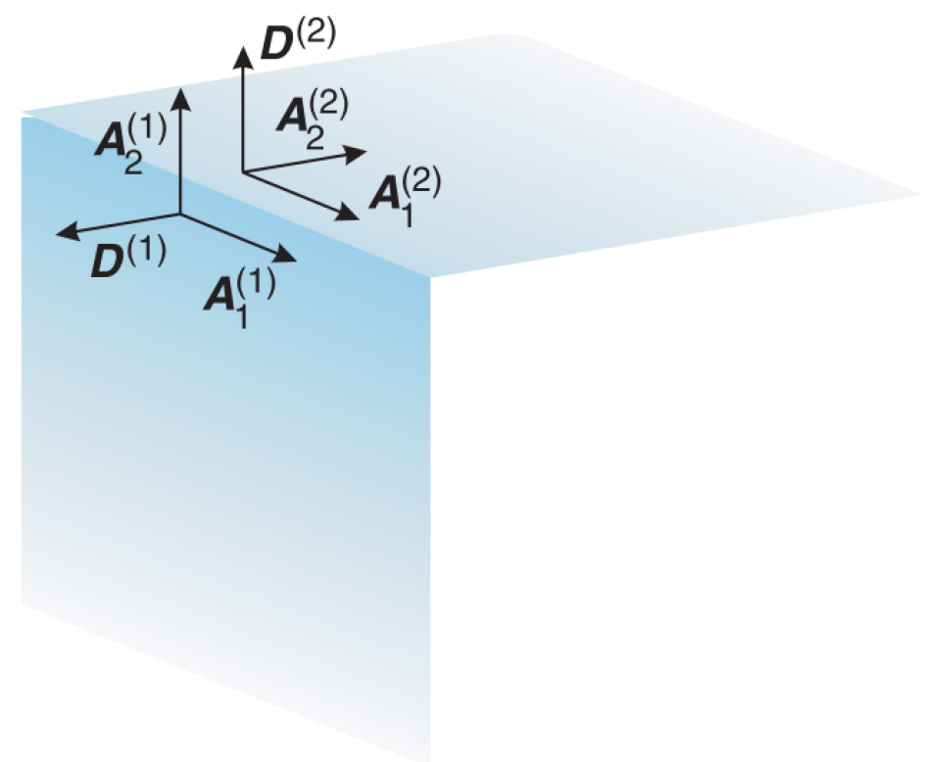
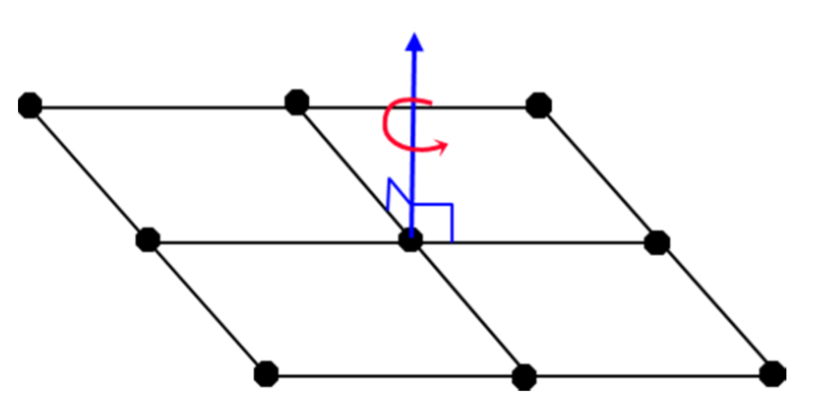
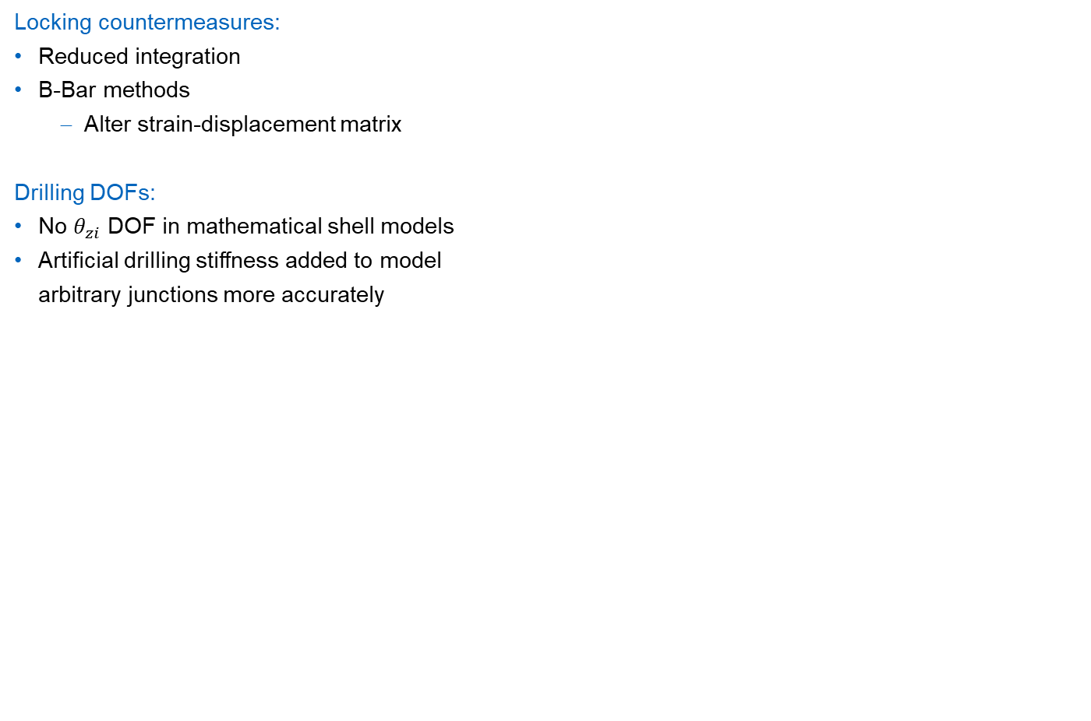
Mechanical expression limitation: finite element technologies
Locking countermeasures:
Reduced integration
B-Bar methods
Alter strain-displacement matrix
Drilling DOFs:
No $θ_{zi}$ DOF in mathematical shell models
Artificial drilling stiffness added to model arbitrary junctions more accurately
Drilling DOF concept [1]
Drilling DOF in shell assembly
[1] https://www.dynamore.de/de/download/papers/2013-ls-dyna-forum/documents/drilling-rotation-constraint-for-shell-elements-in-implicit-and- explicit-analyses

Slide 9
Motivation and objectives
Motivation:
How can the risk of improper shell finite element analyses be managed?
Objectives:
Implement two advanced shell finite elements in the multi-physics code Kratos with the following functionality:
Geometrically linear/non-linear static/dynamic analysis
Linear elastic isotropic and orthotropic laminate materials
Recovery of stresses, strains and Tsai-Wu reserve factor
Investigate the structural modelling of advanced shell finite elements by examining the interaction between structural behaviour, base formulations, enhancing technologies and formulation-mesh-dependency.

Slide 10
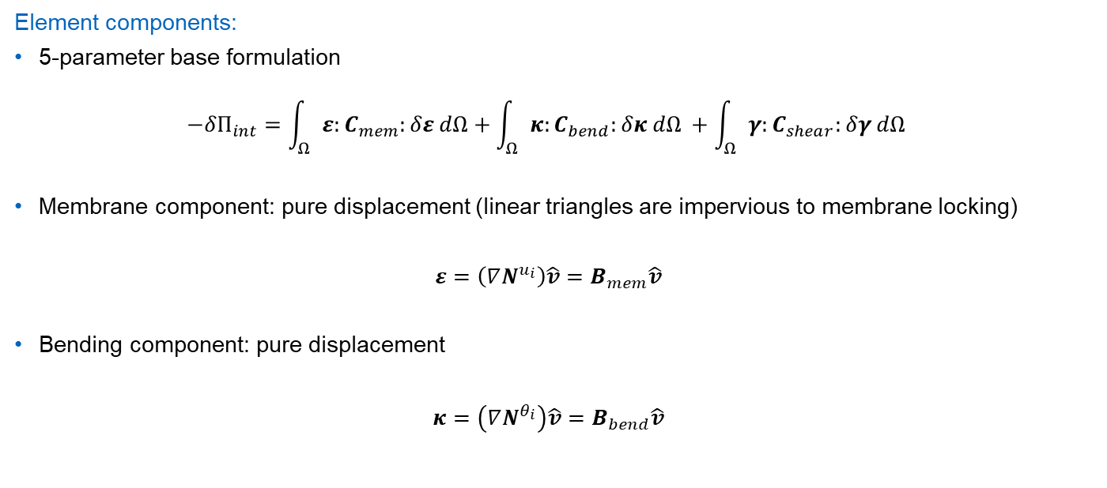
DSG linear triangle shell element
Element components:
5-parameter base formulation $−{δΠ}_{int}=\int_{Ω}{ε:C_{mem}:δε dΩ}+\int_{Ω}{κ:C_{bend}:δκ dΩ }+\int_{Ω}{γ:C_{shear}:δγ dΩ }$
Membrane component: pure displacement (linear triangles are impervious to membrane locking) $ε=\left(∇N^{u_{i}}\right)\hat{v}=B_{mem}\hat{v}$
Bending component: pure displacement $κ=\left(∇N^{θ_{i}}\right)\hat{v}=B_{bend}\hat{v}$

Slide 11
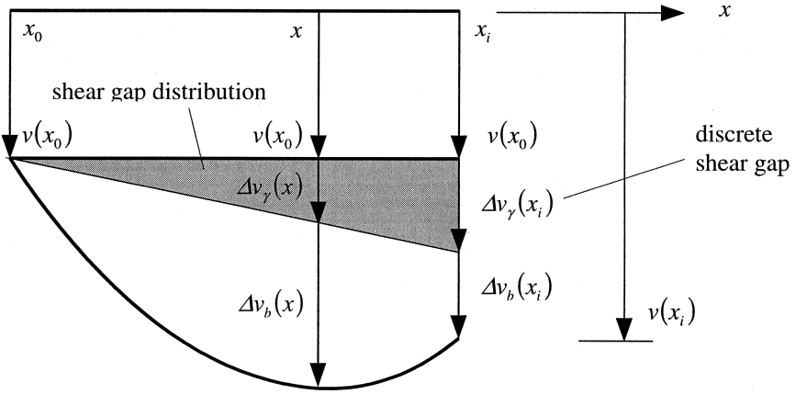
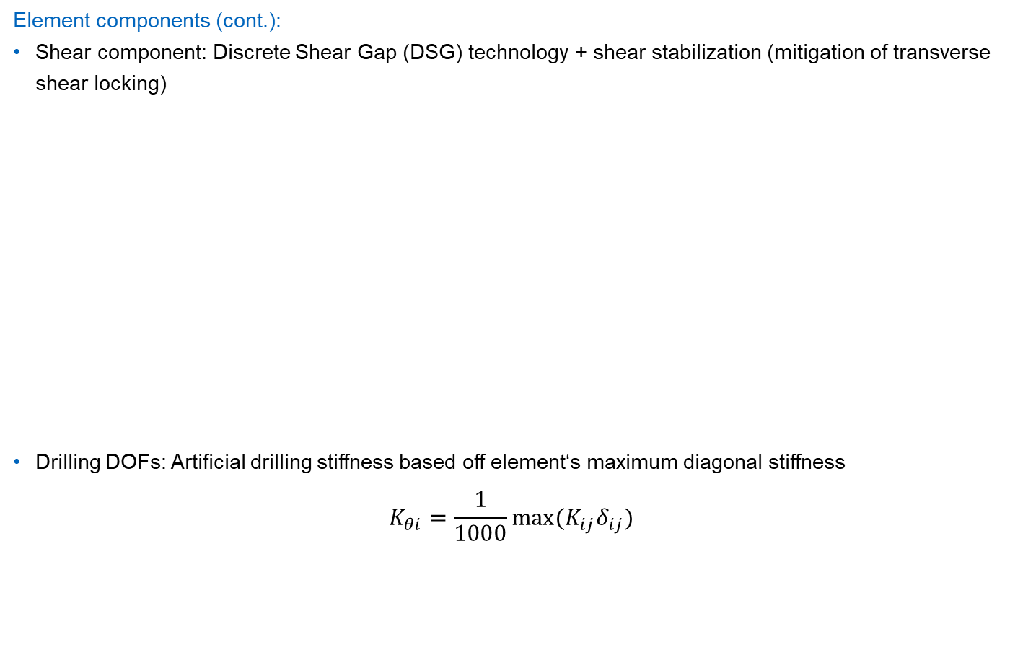
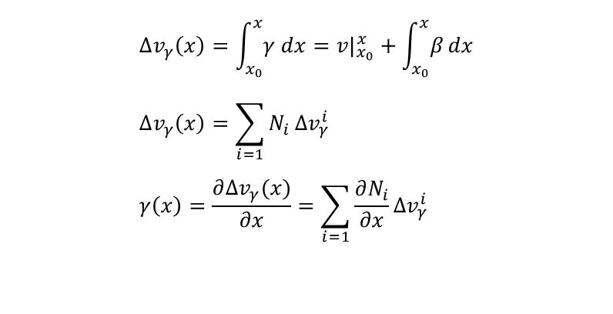
DSG linear triangle shell element
Element components (cont.):
Shear component: Discrete Shear Gap (DSG) technology + shear stabilization (mitigation of transverse shear locking)
Drilling DOFs: Artificial drilling stiffness based off element‘s maximum diagonal stiffness
$$K_{θi}=\frac{1}{1000}max⁡(K_{ij}δ_{ij})$$
$$Δv_{γ}\left(x\right)=\int_{x_{0}}^{x}{γ dx}=v|_{x_{0}}^{x}+\int_{x_{0}}^{x}{β}dx \\ Δv_{γ}\left(x\right)=\sum_{i=1}{N_{i}}{Δv}_{γ}^{i} \\ γ\left(x\right)=\frac{∂∆v_{γ}(x)}{∂x}=\sum_{i=1}{\frac{∂N_{i}}{∂x}}{Δv}_{γ}^{i}$$
DSG concept

Slide 12
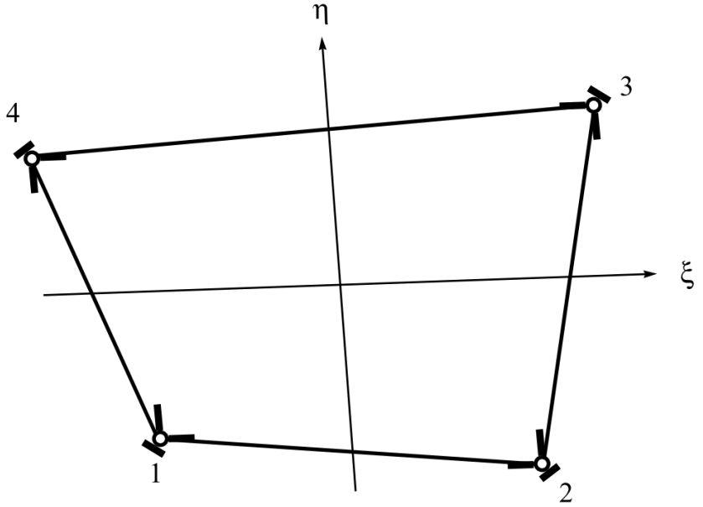
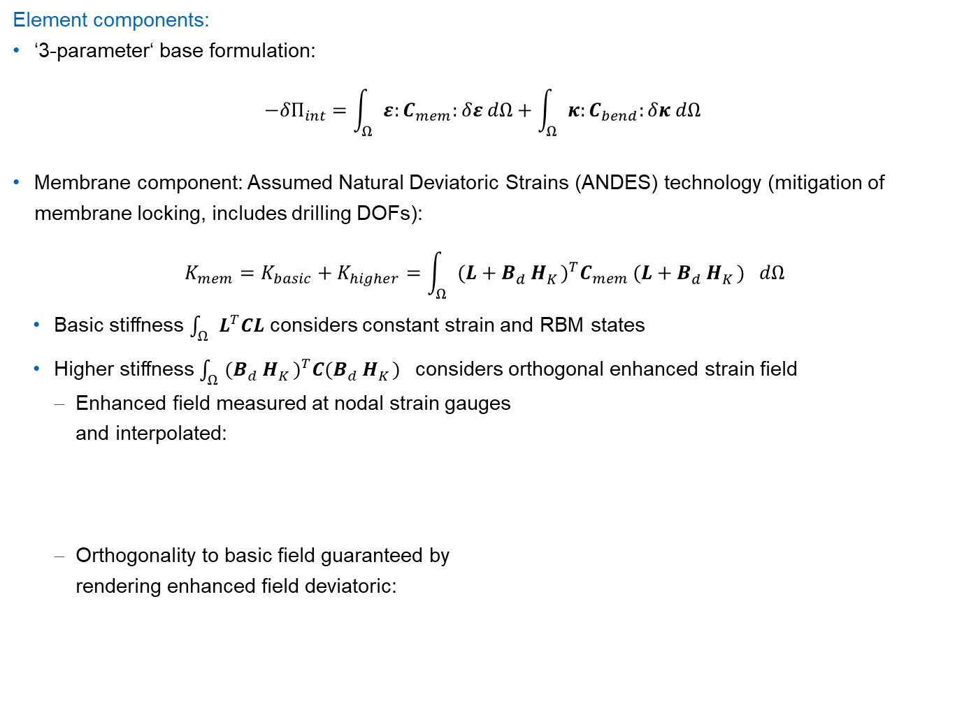
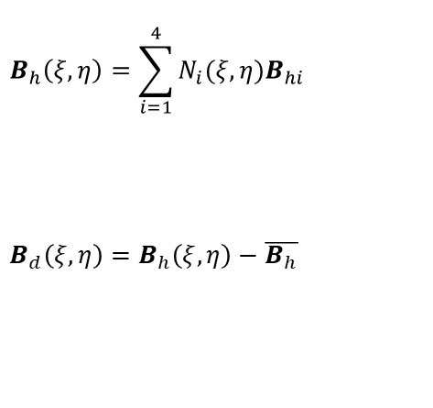
ANDES-DKQ linear quadrilateral shell element
Element components:
‘3-parameter‘ base formulation: $−{δΠ}_{int}=\int_{Ω}{ε:C_{mem}:δε dΩ}+\int_{Ω}{κ:C_{bend}:δκ dΩ }$
Membrane component: Assumed Natural Deviatoric Strains (ANDES) technology (mitigation of membrane locking, includes drilling DOFs): $K_{mem}=K_{basic}+K_{higher}=\int_{Ω}{{(L+B_{d}^{}H_{K}^{})}^{T}C_{mem}}{(L+B_{d}^{}H_{K}^{})}^{}dΩ$
Basic stiffness $\int_{Ω}{L^{T}CL}$ considers constant strain and RBM states
Higher stiffness $\int_{Ω}{{(B_{d}^{}H_{K}^{})}^{T}C{(B_{d}^{}H_{K}^{})}^{}}$considers orthogonal enhanced strain field
Enhanced field measured at nodal strain gauges and interpolated:
Orthogonality to basic field guaranteed by rendering enhanced field deviatoric:
$$B_{h}\left(ξ,η\right)=\sum_{i=1}^{4}{N_{i}(ξ,η)B_{hi}}$$
$$B_{d}\left(ξ,η\right)=B_{h}\left(ξ,η\right)−\overline{B_{h}}$$
ANDES strain gauge layout
Notes:
The ANDES basic stiffness ensures consistency of the element
the higher order stiffness is responsible for stability and accuracy

Slide 13
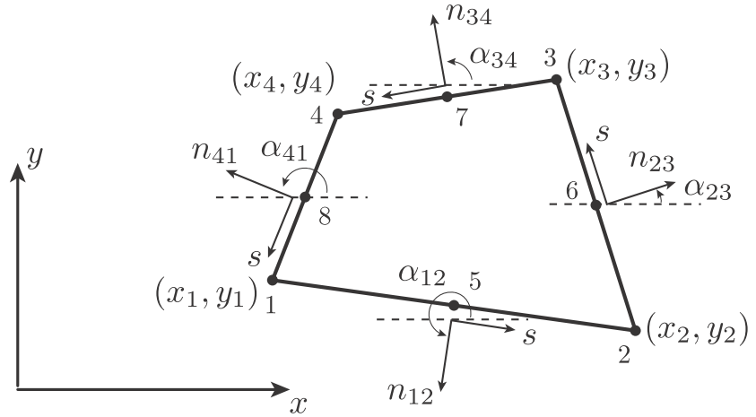
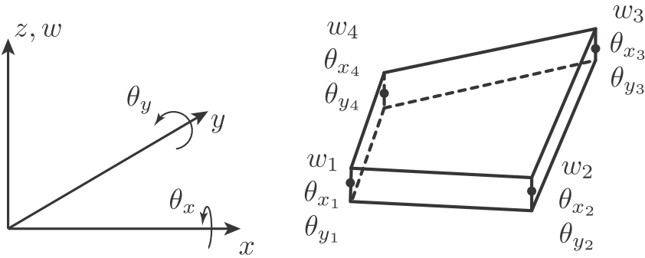
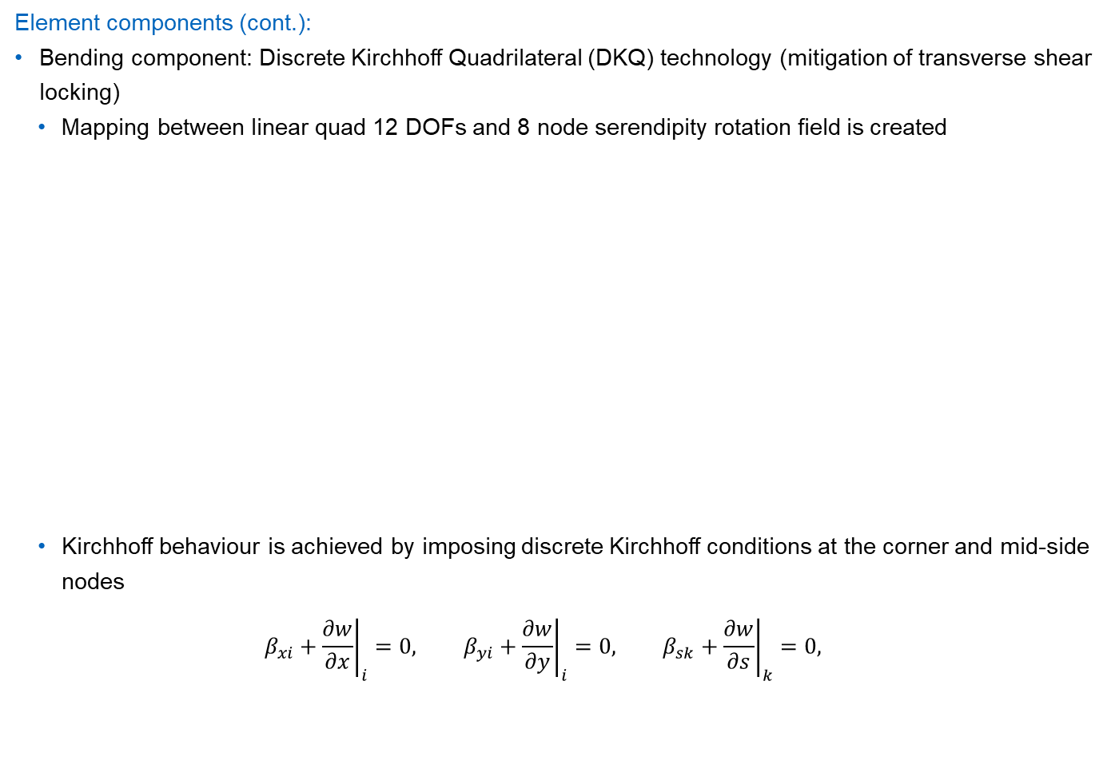
ANDES-DKQ linear quadrilateral shell element (cont.)
Element components (cont.):
Bending component: Discrete Kirchhoff Quadrilateral (DKQ) technology (mitigation of transverse shear locking)
Mapping between linear quad 12 DOFs and 8 node serendipity rotation field is created
Kirchhoff behaviour is achieved by imposing discrete Kirchhoff conditions at the corner and mid-side nodes $β_{xi}+{\left.\frac{∂w}{∂x}\right|}_{i}=0, β_{yi}+{\left.\frac{∂w}{∂y}\right|}_{i}=0, β_{sk}+{\left.\frac{∂w}{∂s}\right|}_{k}=0,$
Linear quad plate
8 node quad Kirchhoff plate

Slide 14
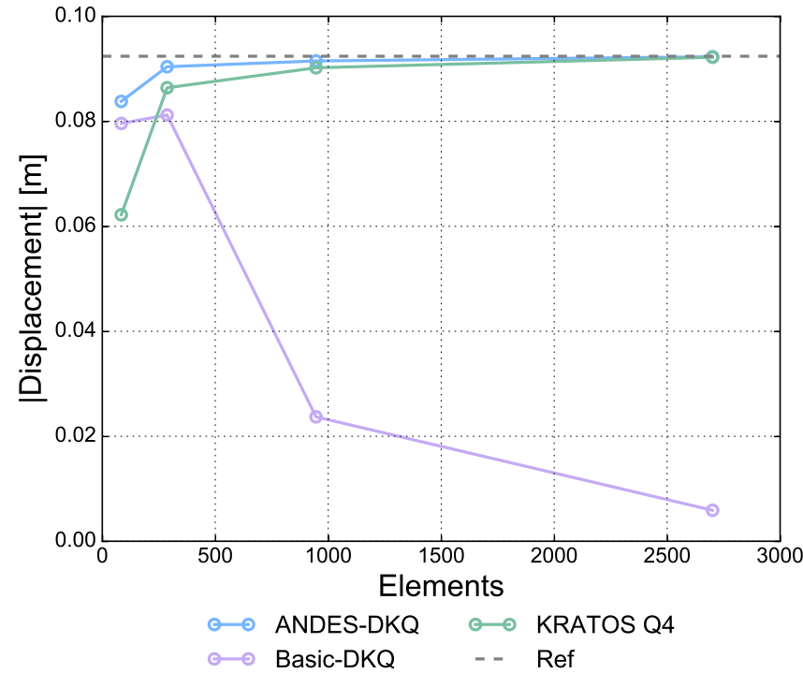
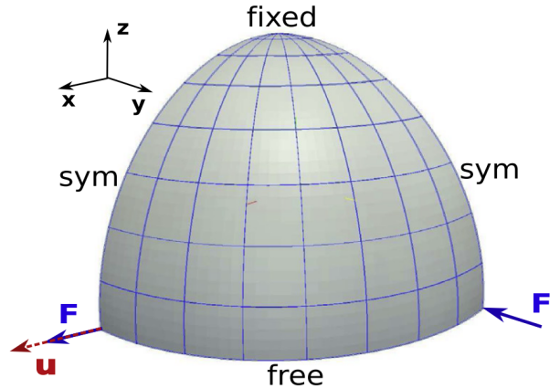
Element validation and capabilities
Validated across tests considering:
Linear/non-linear statics
Linear/non-linear dynamics
Linear elastic isotropic and orthotropic laminate materials
Capabilities:
Above tests
Lumped and consistent mass matrices
Recovery of stresses, strains, Von Mises stress, integrated forces and Tsai-Wu reserve factor
Pinched hemisphere validation test
Quad element results

Slide 15
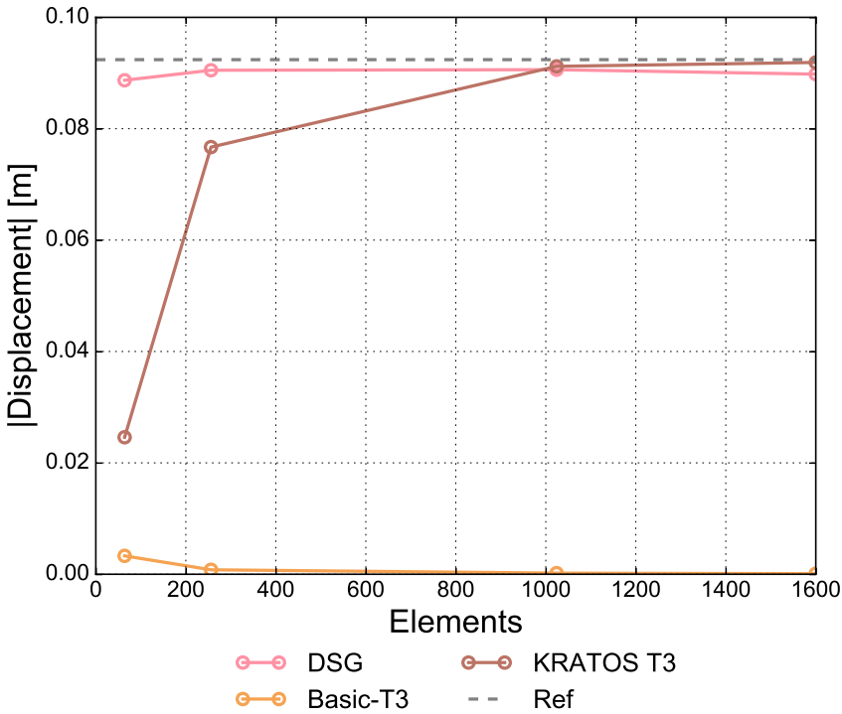
Element validation and capabilities
Validated across tests considering:
Linear/non-linear statics
Linear/non-linear dynamics
Linear elastic isotropic and orthotropic laminate materials
Capabilities:
Above tests
Lumped and consistent mass matrices
Recovery of stresses, strains, Von Mises stress, integrated forces and Tsai-Wu reserve factor
Pinched hemisphere validation test
Triangle element results

Slide 16
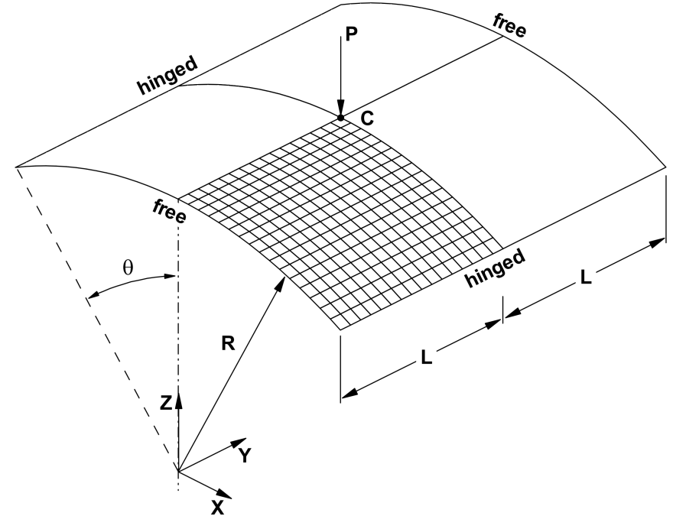
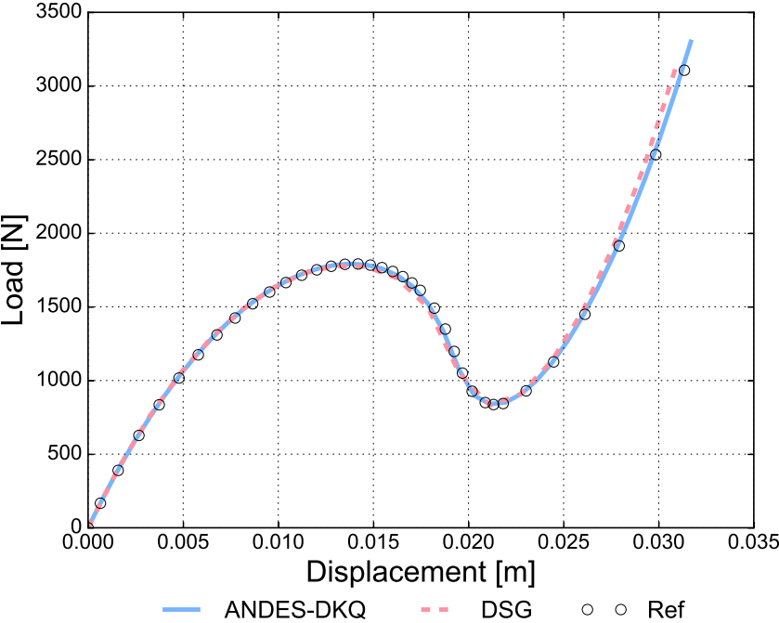
Element validation example
Composite [90/0/90] hinged roof snapthrough:

Slide 17
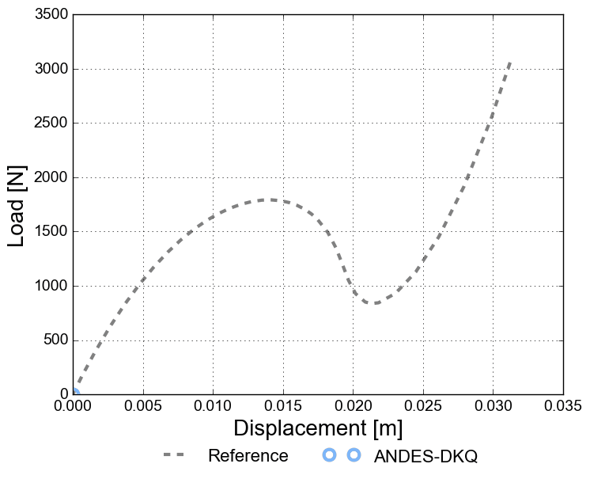
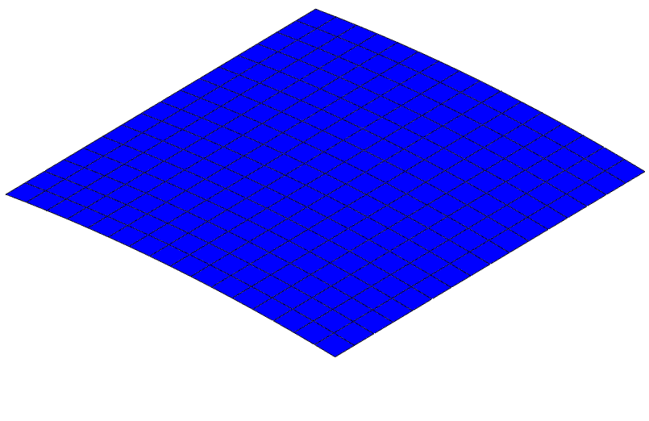
Element validation example
Composite [90/0/90] hinged roof snapthrough

Slide 18
Motivation and objectives
Motivation:
How can the risk of improper shell finite element analyses be managed?
Objectives:
Implement two advanced shell finite elements in the multi-physics code Kratos with the following functionality:
Geometrically linear/non-linear static/dynamic analysis
Linear elastic isotropic and orthotropic laminate materials
Recovery of stresses, strains and Tsai-Wu reserve factor
Investigate the structural modelling of advanced shell finite elements by examining the interaction between structural behaviour, base formulations, enhancing technologies and formulation-mesh-dependency.

Slide 19
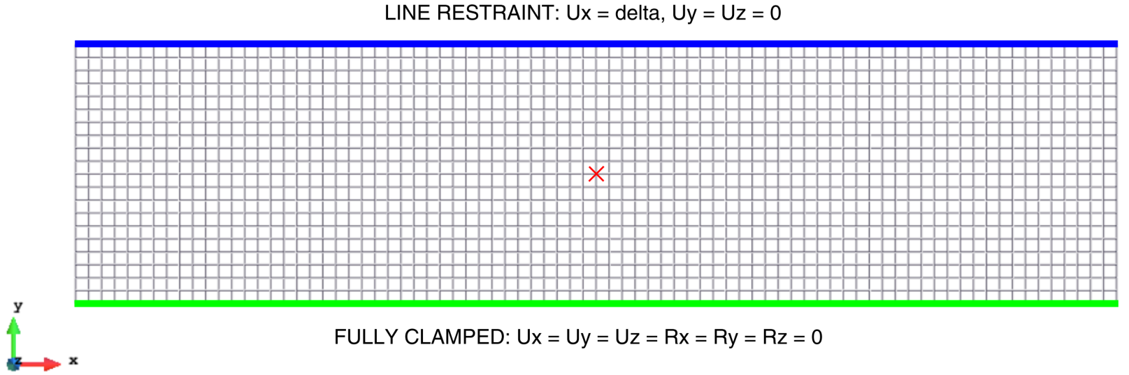
Plate shear wrinkling study
Problem setup:
Geometically non-linear static analysis
Flat plate 1.2 x 0.3 x 0.005m with E=1000 and ν=0.0
δ increased from 0.0 to 0.015m
Minor point load F_{z} = -100N to induce instability

Slide 20
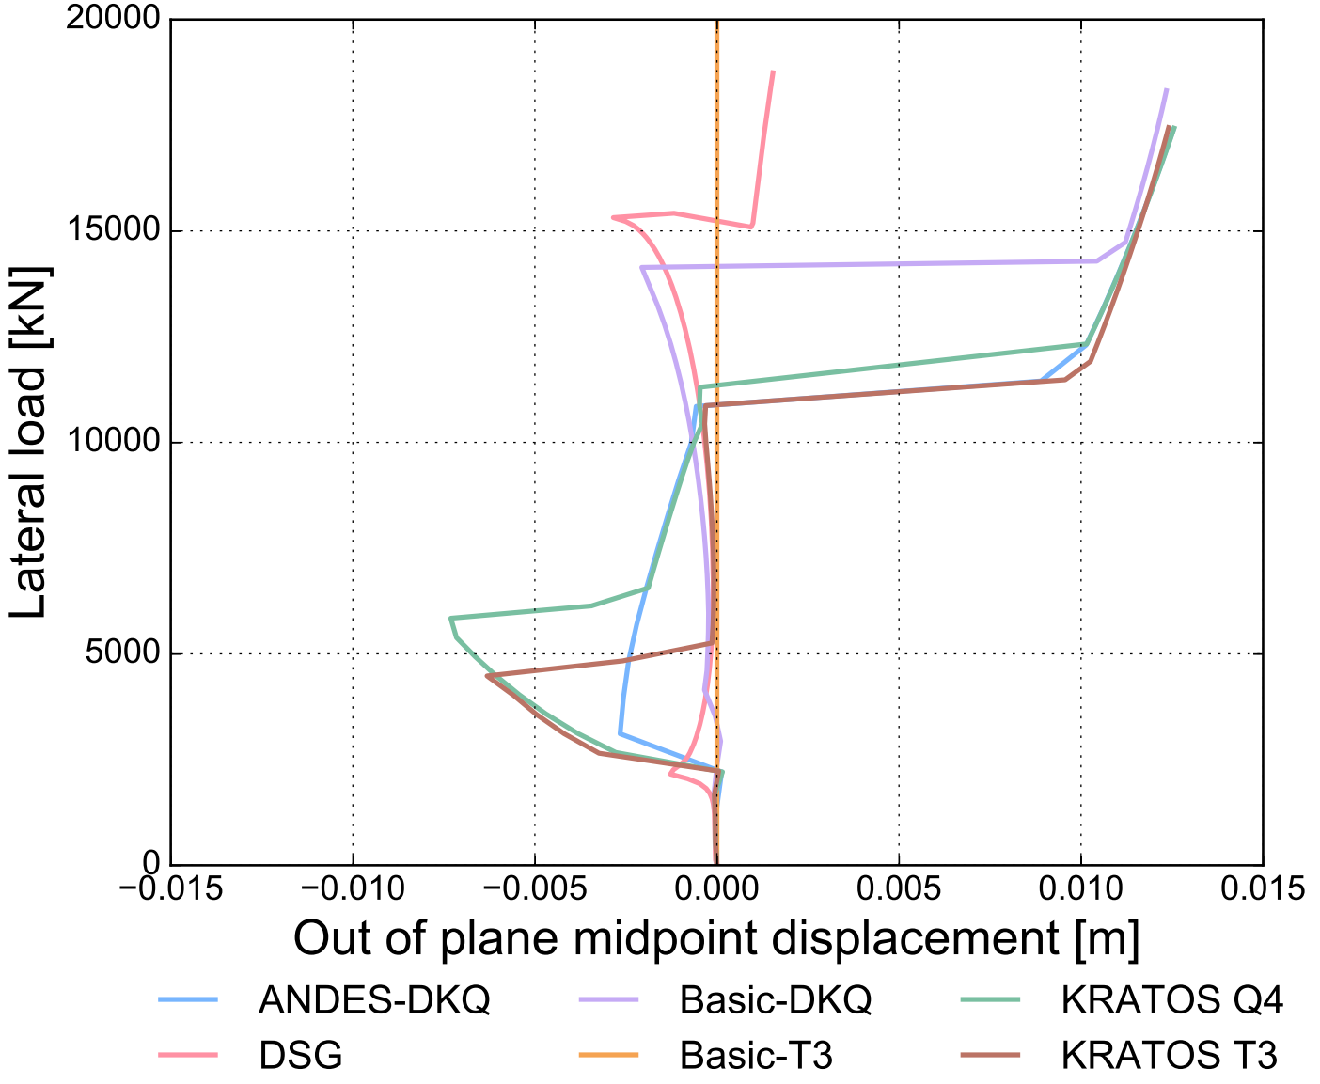
Plate shear wrinkling study results
Brief discussion:
Complex non-linear behaviour from most elements
Effect of DSG technology
Effect of ANDES technology

Slide 21
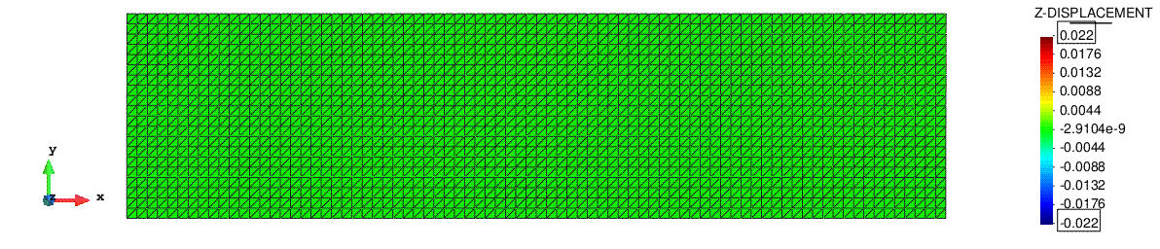
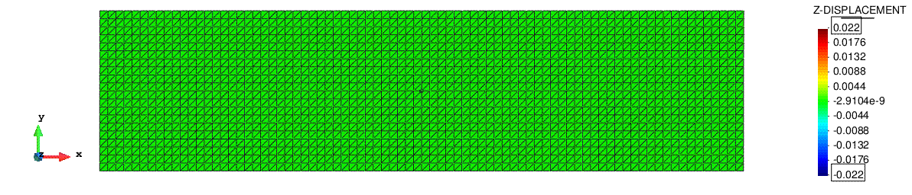
Plate shear wrinkling study results
Brief discussion point 1 – DSG technology in linear triangle elements:
DSG enhancement is very effective
In general, for 5 parameter based formulations, transverse shear locking mitigation is necessary for resonable results
DSG element. Bifurcation resolved.
Basic-T3 element (DSG disabled). Never bifurcates.

Slide 22
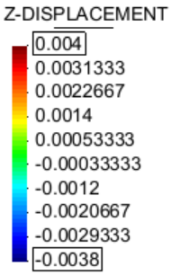
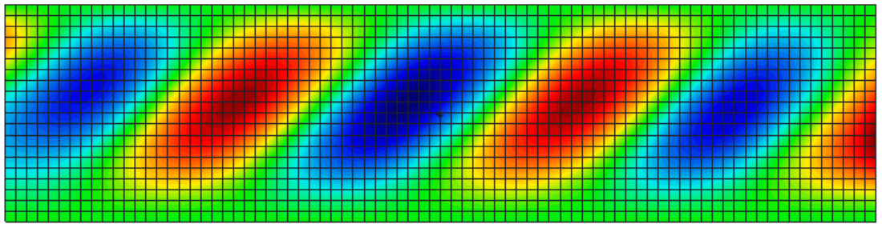
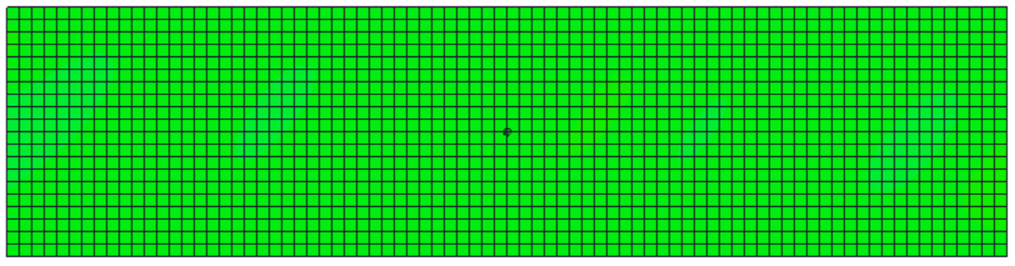
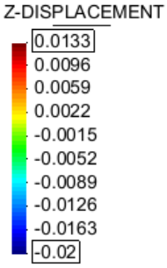
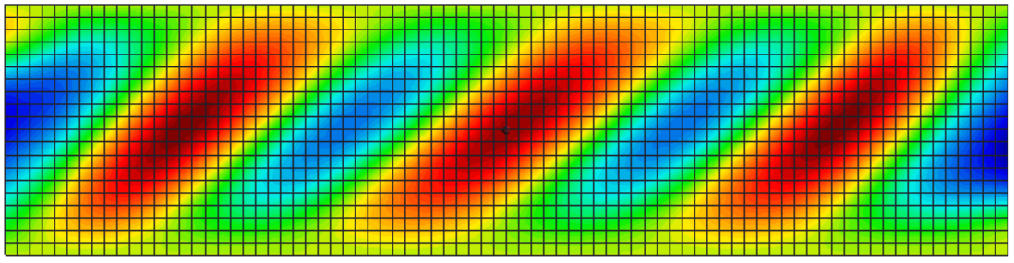
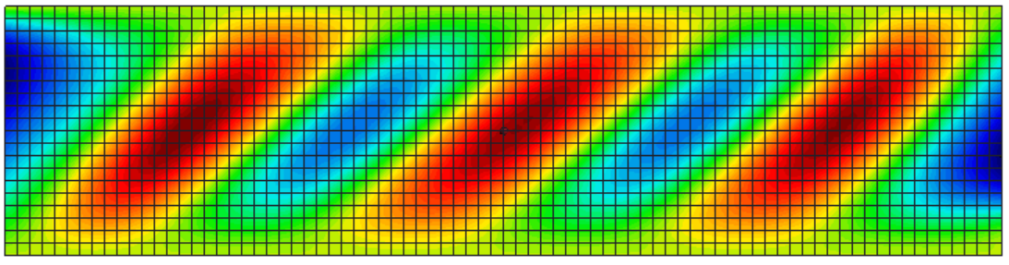
Plate shear wrinkling study results
Brief discussion point 2 - ANDES technology in linear quad elements:
Although problem is initially flat, membrane locking regulates onset of instability here
Remember to select technologies on undeformed AND predicted deformed behaviour
15% maximum lateral deflection
100% maximum lateral deflection
ANDES-DKQ element
Basic-DKQ element (ANDES disabled)
ANDES-DKQ element
Basic-DKQ element (ANDES disabled)
Notes:
Consider 15% max lateral deflection. ANDES already buckled, other isn’t. Clearly the membrane mitigation is making a difference here.
One may be forgiven for thinking the initially flat plate, with no curvature, will have no membrane locking – but this example shows it is important to consider the deformed shape too when considering enhancing technologies

Slide 23
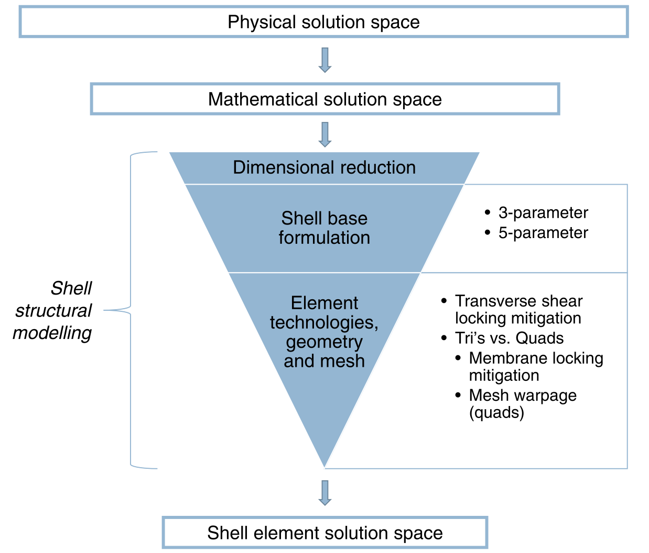
Shell structural modelling
Overview:
Effect and key components of shell structural modelling
Notes:
the choice of dimensional reduction imposes a significant filter of possible resolvable results.
Within the shell regime, the selection of elements based on 3-parameter or 5-parameter models appears to limit resolvable possibilities the greatest. Thus, one must consider whether Kirchhoff-Love or Reissner-Mindlin kinematics dominate the current problem and select base formulations accordingly.
5-parameter models require transverse shear locking mitigation technologies
a trade-off between the increased resolving power of quadrilaterals (4 gauss points) susceptible to membrane locking and the limited resolving power of triangles (1 gauss point) invulnerable to membrane locking must be evaluated
Two critical factors key in this trade-off is the predisposition of the mesh to membrane locking (ie. highly warped quadrilaterals) and the effectiveness of the membrane locking mitigation technology.
The plate shear wrinkling example suggests an additional caveat that mesh susceptibility to membrane locking must be considered over the deformed state too, not just the undeformed.
The culmination of these modelling decisions effectively determines what the shell elements can or can not resolve, and thus, drives the results you obtain.

Slide 24
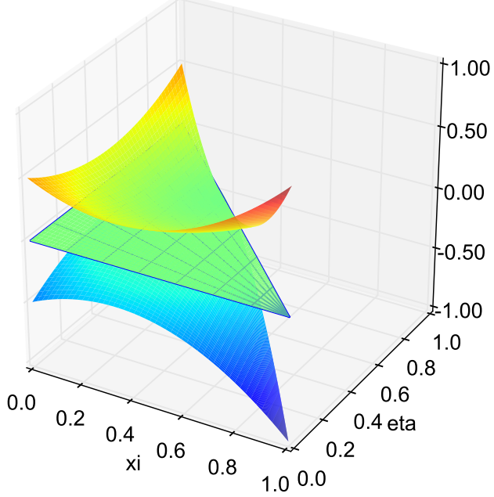
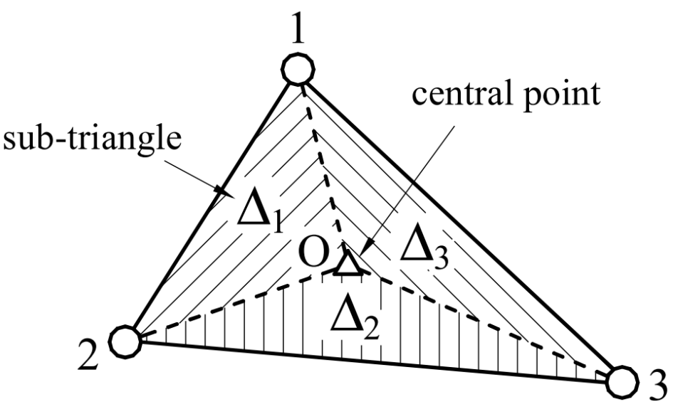
Extension of DSG linear triangle element technology
Original DSG linear triangle formulation:
Depdendent on nodal ordering
Effect diminishes with mesh refinement
DSG extensions to address numbering dependency:
DSGc3 proof of concept [Bletzinger]
Cell-Smoothed DSG (CS-DSG) [T. Nguyen-Thoi et al., 2013]
CS-DSG or DSG?:
DSG preferred for 99% of scenarios
CS-DSG for very coarse meshes (ca. < 10 elements)
It all comes back to understanding the element‘s capabilities and limitations!
Displacement gap field
Shear displacement field
KT displacement field
DSGc3 proof of concept
CS-DSG approach
Notes:
Lastly, let us consider an example of formulation-mesh-dependency.
The original DSG formulation is dependent on nodal ordering, although this diminishes with refinement
Several attempts have been made to overcome this dependency
DSGc3
Cell-Smoothed DSG by Nguyen Thoi, which I also implemented in Kratos and validated that it is indeed invariant of nodal numbering.
So this begs the question: should people use the CS-DSG or the original DSG

Slide 25
Motivation and objectives
Motivation:
How can the risk of improper shell finite element analyses be managed?
Objectives:
Implement two advanced shell finite elements in the multi-physics code Kratos with the following functionality:
Geometrically linear/non-linear static/dynamic analysis
Linear elastic isotropic and orthotropic laminate materials
Recovery of stresses, strains and Tsai-Wu reserve factor
Investigate the structural modelling of advanced shell finite elements by examining the interaction between structural behaviour, base formulations, enhancing technologies and formulation-mesh-dependency.
Notes:
This talk has addressed the motivating question of how can the risk of improper shell finite element analyses be mitigated with the completion of two objectives.
The first objective considered the implementation and validation of 2 advanced shell finite elements in Kratos. Although using advanced elements like these definitely reduces the risk of spurious analyses, it does not completely eliminate it.
The second objective considered the structural modelling of these elements by examining the interaction between structural behaviour, base formulations, enhancing technologies and formulation-mesh-dependency. Here it was shown that a correct understanding of shell theories and the shell finite elements themselves gives rise to the correct structural modelling of shell finite elements
Finally, when these two constituents, advanced shell finite elements and their proper structural modelling, are considered together, the risk of spurious analyses is effectively mitigated, producing confident and accurate results.

Slide 26
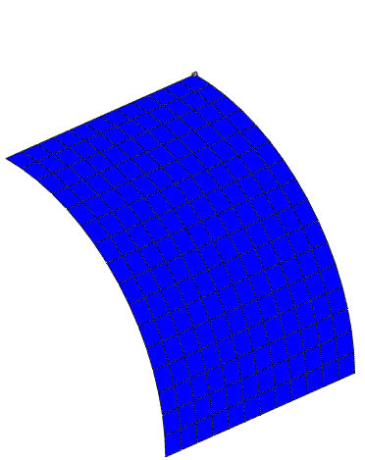
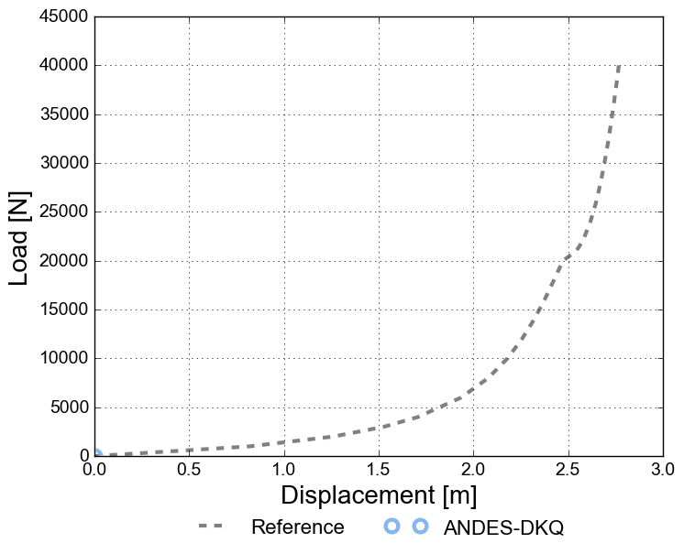
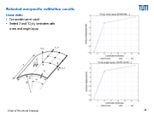
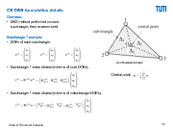
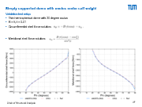
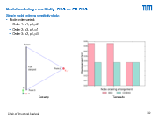
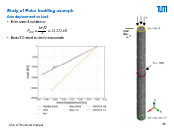
Thank you
Open cylinder pull-out verification test
Further discussion:
CS-DSG formulation details | DSG vs CS-DSG study | Dome analysis and Stenberg stabilisation | Selected composite validation results | Euler buckling study

Slide 27
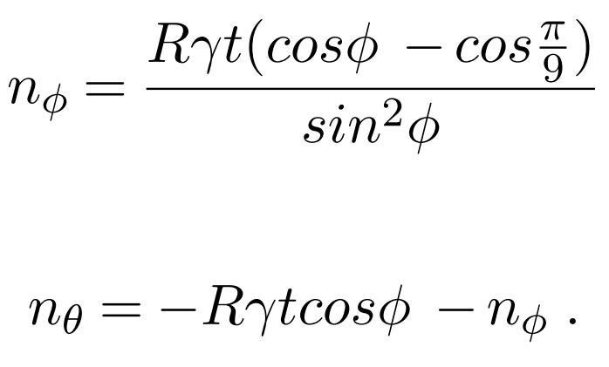
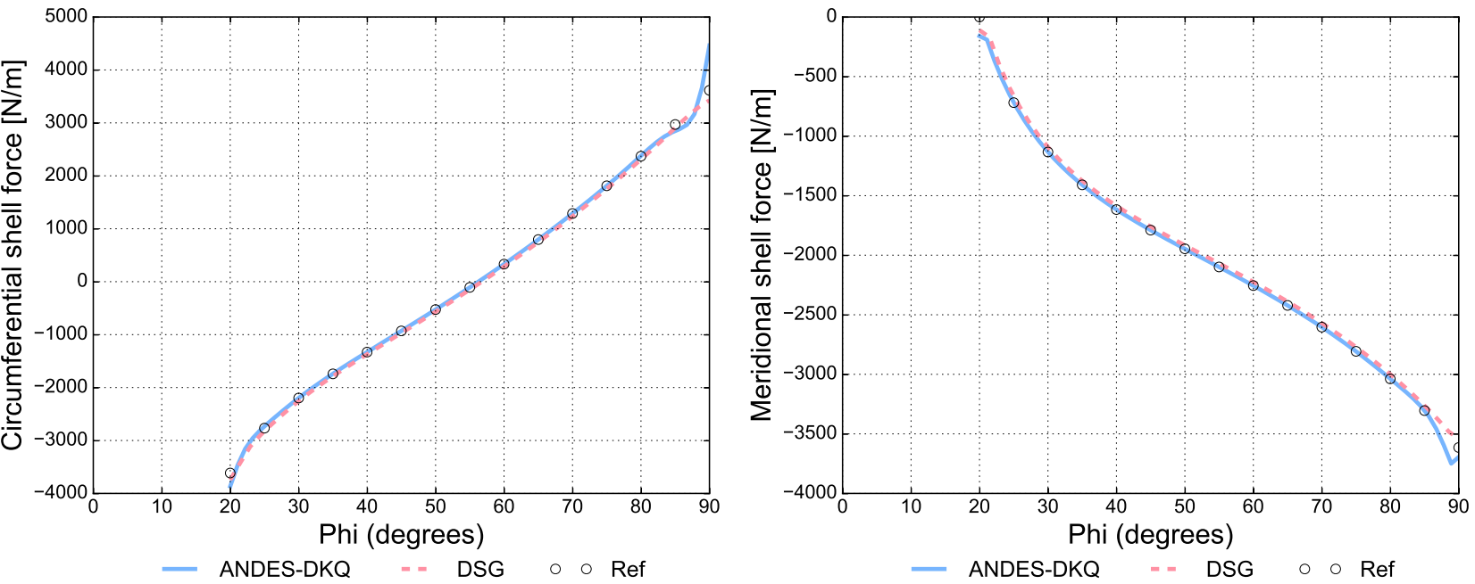
Simply supported dome with oculus under self weight
Validation test setup:
Thin hemi-spherical dome with 20 degree oculus
R = 5, t = 0.01
Circumferential shell force solution:
Meridional shell force solution:

Slide 28
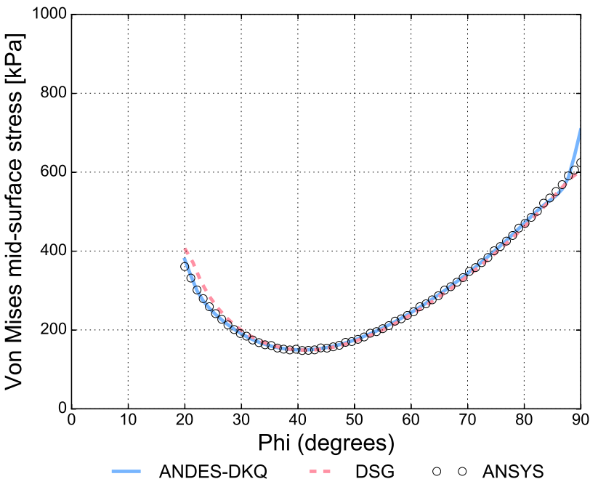

Simply supported dome with oculus under self weight
Von Mises stress results:

Slide 29



Stenberg shear stabilisation
Effect of Stenberg shear stabilisation:
Improves 5-parameter performance by modifying shear part of constitutive matrix with dimensionless tau
Effect of stabilisation in a dome without an oculus:

Slide 30




CS-DSG formulation details
Overview:
DSG method performed on each sub-triangle, then re-assembled
Sub-triangle 1 example:
DOFs of each sub-triangle:
Sub-triangle 1 shear strains (in terms of local DOFs):
Sub-triangle 1 shear strains (in terms of meta-triangle DOFs):
CS-DSG element division
Central point:

Slide 31



CS-DSG formulation details
Sub-triangles 2 and 3:
The same process for sub-triangle 1 can be repeated, yielding:
Meta-triangle shear strains:
Re-assembled via an area-average:

Slide 32

Nodal ordering sensitivity: DSG vs CS-DSG
Simple nodal ordering sensitivity study:
Node order varied:
Order 1: p1, p3, p2
Order 2: p3, p2, p1
Order 3: p2, p1, p3
Test setup
Test results

Slide 33
Appraisal of DSG linear triangles technologies
In general analysis should we use the DSG or CS-DSG?
Let‘s answer this by considering two questions:
1. How fast does the nodal dependency of the DSG element dissipate to negligible levels?
2. How gross is the additional computational effort required for the CS-DSG element?

Slide 34

Appraisal of DSG linear triangles technologies
Nodal numbering dependency study:
Two BC cases to extricate nodal numbering dependency
Study BCs and mesh refinement

Slide 35

Appraisal of DSG linear triangles technologies
Dissipation rate of DSG nodal ordering dependency
CS-DSG invariant across both BCs
DSG dependency diminishes very quickly
Difference with 8 element mesh essentially negligible
Study displacement results

Slide 36

Appraisal of DSG linear triangles technologies
Computational cost vs. error for DSG and CS-DSG elements
CS-DSG shear B-matrix takes 12% longer to construct than the DSG
Similar % error achieved very quickly
Once again, difference with 8 element mesh essentially negligible
12% diff.
Error vs computational cost

Slide 37
Appraisal of DSG linear triangles technologies
Summary:
CS-DSG shows no nodal ordering dependency
However, DSG dependency quickly diminishes
CS-DSG shear B-matrix takes 12% longer to construct than the DSG
Reccomendation:
DSG element for 99% of practical scenarios with normal meshes
CS-DSG for rare scenarios with very coarse meshes
It all comes back to understanding the element‘s capabilities and limitations!

Slide 38


Shell obstacle course: DSG and CS-DSG
Scordelis-Lo roof:

Slide 39


Shell obstacle course: DSG and CS-DSG
Pinched cylinder:

Slide 40



Shell obstacle course: DSG and CS-DSG
Pinched hemisphere:

Slide 41



Selected composite validation results
Linear static:
Composite barrel vault
Tested 2 and 10 ply laminates with cross and angle layup

Slide 42
Selected composite validation results
Non-linear static:
Composite hinged roof snap-through
[90/0/90] layup

Slide 43
Selected composite validation results
Composite [90/0/90] hinged roof snapthrough

Slide 44



Selected composite validation results
Quantity recovery:
Tensile test
[0/90/90/0] layup

Slide 45


Selected composite validation results
Quantity recovery:
Tensile test
[0/90/90/0] layup

Slide 46



Study of Euler buckling example
Axial displacement vs Load:
Euler case 4 solution is:
$$P_{crit}=\frac{4π^{2}EI}{L^{2}}=13 222 kN$$
Basic-T3 result is clearly inaccurate
Axial disp. u_{z}

Slide 47

Study of Euler buckling example (cont.)
Lateral displacement vs Load:
Basic-T3 yet again inaccurate
Largely similar behaviour between elements, although differences clearly exist
Lateral disp. u_{x}

Slide 48

Study of Euler buckling example (cont.)
Kratos-T3 element deformation
Exhibits high degree of ovalisation

Slide 49

Study of Euler buckling example (cont.)
DSG element deformation
Exhibits minimal ovalisation

Slide 50


Study of Euler buckling example (cont.)
Deformation at the onset of instability
Kratos-T3 element
‘3-parameter’ base
ANDES-DKT technologies
3 gauss points
DSG element
5-parameter base
DSG technology
1 gauss point

